Slide 1

Fake News Detection
Subject
Advanced Algorithms (CS16001 & CS26001)
Branch
M. TECH CSE AND CSIS 1st Year
Submitted By
Deepaka Hebbar K A (24CSM2S01) (MTECH CSIS)
Udit Jain (24CSM1R23) (MTECH CSE)
Digvijay Singh Panwar (24CSM2R10) (MTECH CSIS)
Under the guidance of -
Prof. Manish Kumar Bajpai

Slide 2
Problem Statement
The spread of fake news on social media undermines public trust, societal integrity, and democratic processes. This study evaluates supervised AI algorithms and proposes a predictive framework to enhance fake news detection, ensuring accurate classification and information integrity in digital and IoT-driven environments.

Slide 3
Introduction
Social media's rapid information dissemination has led to an increase in fake news, negatively impacting public trust, influencing opinions, and even affecting democratic processes.
This rapid information flow also accelerates the spread of misinformation and fake news, impacting public trust, societal opinions, and democracy.
Addressing this issue, AI advancements provide powerful tools for fake news detection and classification.
This study leverages AI algorithms, including the SGDClassifier, perceptron, and Random Forest, refined specifically for text classification.

Slide 4
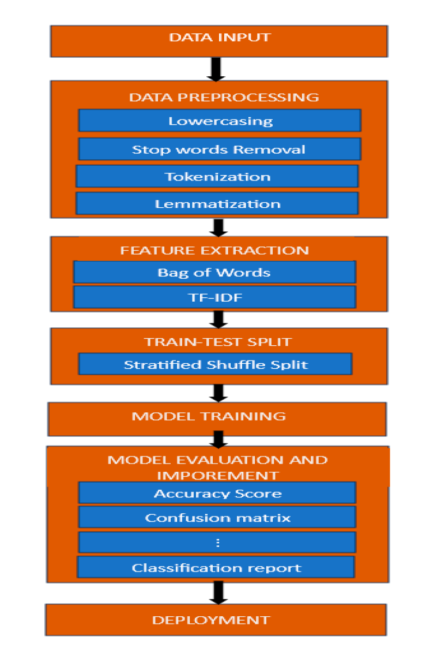
Architecture of Fake news detection model
Data Preprocessing
This initial step cleans and prepares raw text data to be suitable for analysis and model input.
Model Training Phase
This phase involves training various machine learning models on the processed data to learn patterns indicative of fake or real news.
Model Evaluation
After training, each model is individually evaluated to determine its performance.
Final Prediction
This stage outputs the final classification of a news article based on the ensemble model's prediction.

Slide 5
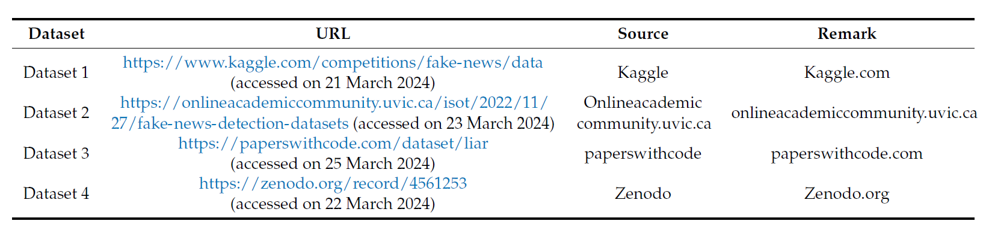
Dataset

Slide 6
Technologies Used
Data Manipulation:
Pandas
NumPy
Text Preprocessing:
NLP Libraries
Regular Expressions
WordCloud
Feature Extraction:
CountVectorizer and TfidfVectorize
TfidfTransformer
Machine Learning Algorithms:
Decision Tree
Random Forest
AdaBoost
Perceptron
Stochastic Gradient Descent
Logistic Regression
Evaluation Metrics:
Accuracy Score
Precision,Recall,F! Score
Matthews Correlation Coefficient
Cohen’s Kappa Score
ROC-AUC Score

Slide 7
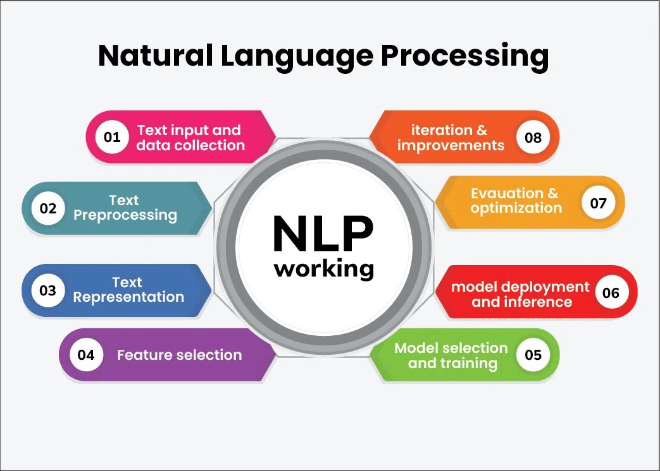
Natural Language Processing
Natural Language Processing (NLP) is a subfield of artificial intelligence (AI) and linguistics focused on enabling machines to understand, interpret, and respond to human languages. NLP combines aspects of computer science, data analysis, and linguistics to process and analyze large amounts of text or speech data.

Slide 8

Model Training Phase
Perceptron (Artificial Neural Network): A linear classifier that uses a linear predictor function. Additionally, this study uses Multilayer Perceptron (MLP), which are neural networks with multiple layers for handling more complex patterns​​.
Initialize weights,
iterate over the training data,
update weights based on prediction errors using the Perceptron learning rule.

Slide 9

Model Training Phase
AdaBoost Classifier: An ensemble technique that combines multiple weak classifiers to create a robust predictive model. AdaBoost iteratively adjusts the weights of weak classifiers to correct errors in previous iterations.
Train a weak classifier
adjust sample weights based on misclassifications
Combine weak learners into a strong ensemble.

Slide 10

Model Training Phase
Decision Tree Classifier: A supervised learning algorithm used for both regression and classification. It creates a model resembling a tree structure, where each node represents a decision rule for categorization​.
Calculate Entropy of the Root Node
For Each Feature, Compute Information Gain
Choose the Feature with Maximum Information Gain
Repeat the Process Recursively

Slide 11

Model Training Phase
Random Forest Classifier: An ensemble learning method that builds multiple decision trees and averages their predictions to improve accuracy and reduce overfitting​.
Split data into training and test sets,
train multiple decision trees on bootstrapped samples,
aggregate their predictions.

Slide 12

Model Training Phase
Stochastic Gradient Descent (SGD) Classifier: A highly efficient optimization algorithm that iteratively updates model parameters by moving in the direction of the negative gradient of the loss function. It is particularly effective for large datasets and helps minimize computational requirements
Initialize weights
Apply stochastic gradient descent to minimize the loss function iteratively on the training data.

Slide 13
Model Training Phase
Logistic Regression :Logistic Regression is a classification algorithm that uses a linear model and the sigmoid function to predict probabilities. It is trained by optimizing the log-likelihood function using techniques like gradient descent.
Initialize Weights
Calculate Predicted Probabilities
Compute Loss
Optimize Weights

Slide 14
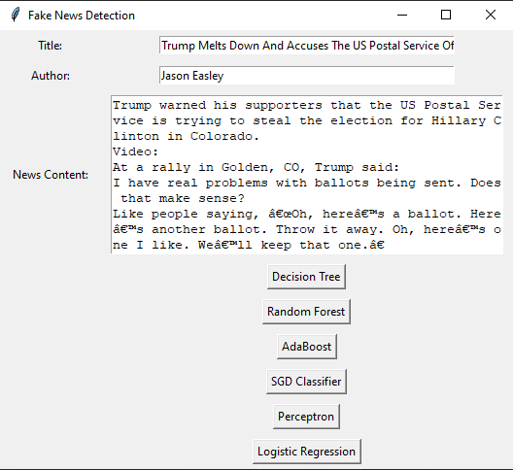
User Interface

Slide 15
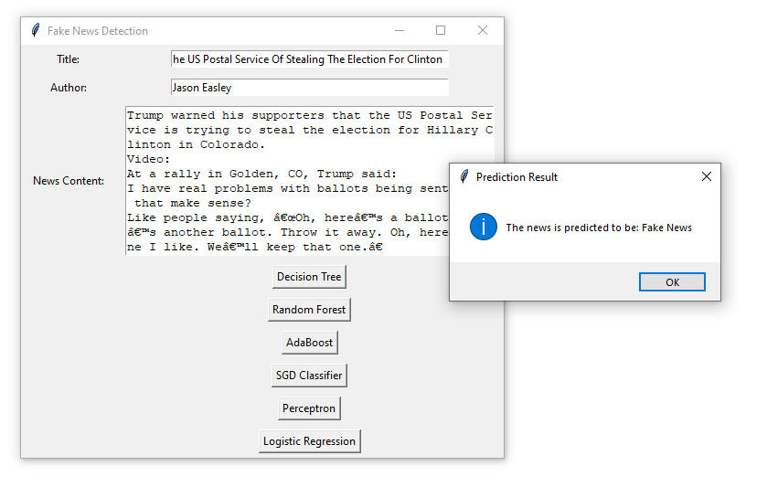
User Interface
Result

Slide 16

Thank You

